Slide 1
Graphical Abstract—Author Instructions
We have created blank templates on slides 2 and 3 that you may use to make your Graphical Abstract. Click here for the Adobe Illustrator version and follow these instructions.
We have provided examples using these two templates on slides 4–8. Slides 7-8 are examples for computational protocols.
You can change the number of boxes to best fit your needs, as illustrated on slides 5 and 7. We recommend no more than 6 boxes to ensure readability.
We have created an asset library on slides 9 and 10. You may fill out a blank template with these assets. Click here for the Adobe Illustrator version and follow these instructions.
Your Graphical Abstract should include an overview of the major steps of the protocol with notes on the timing for each major step.
Label each major step (step 1, step 2,…etc) as appropriate.
Please ensure the Graphical Abstract is the correct size and shape (1200 pixels square or 4 x 4 in at 300 dpi). Cell Press GA guidelines are here.
To export the image from PowerPoint at 300 dpi, follow the instructions here or email msun@cell.com for help. To export the image from Adobe Illustrator at 300 dpi, follow these instructions.
Please share your feedback on this template and how it might be improved.

Slide 2


Step 1
Step 2
5 min
10 min
Order Parts
Body text
Header
Body text
Step 3
Step 4
Timing
10 min
20 min
Header
Body text
Header
Body text

Slide 3

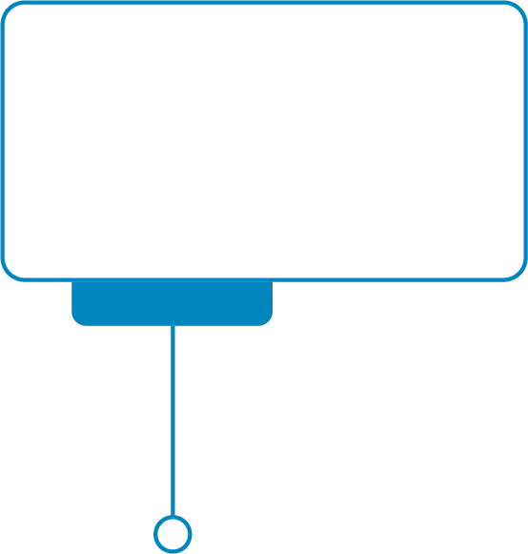


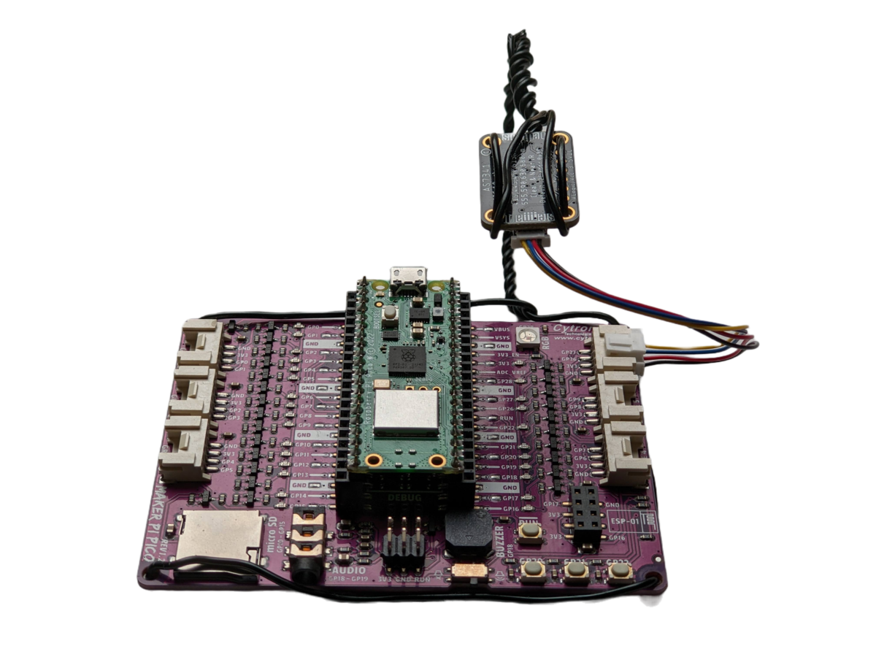
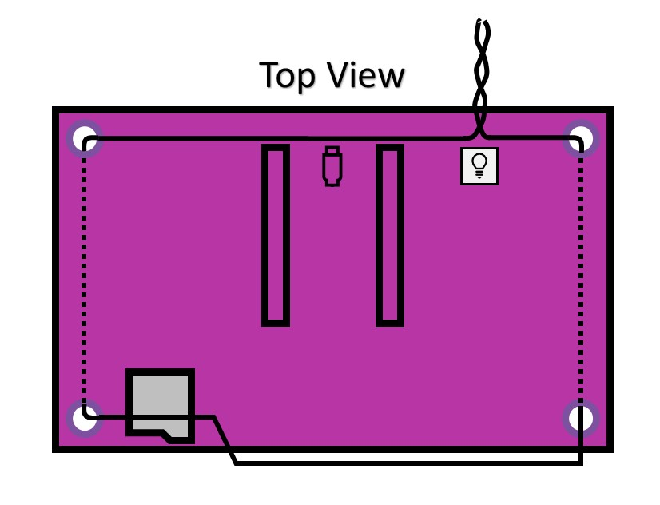
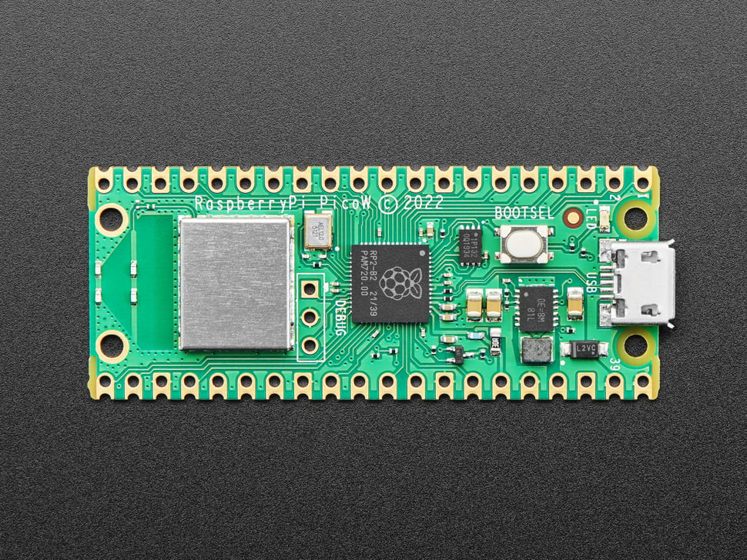

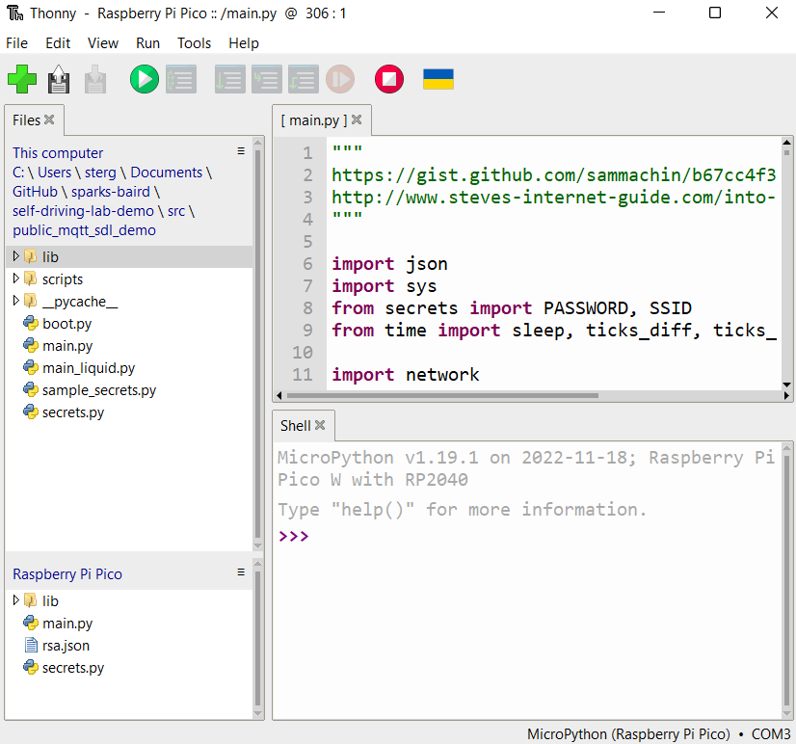
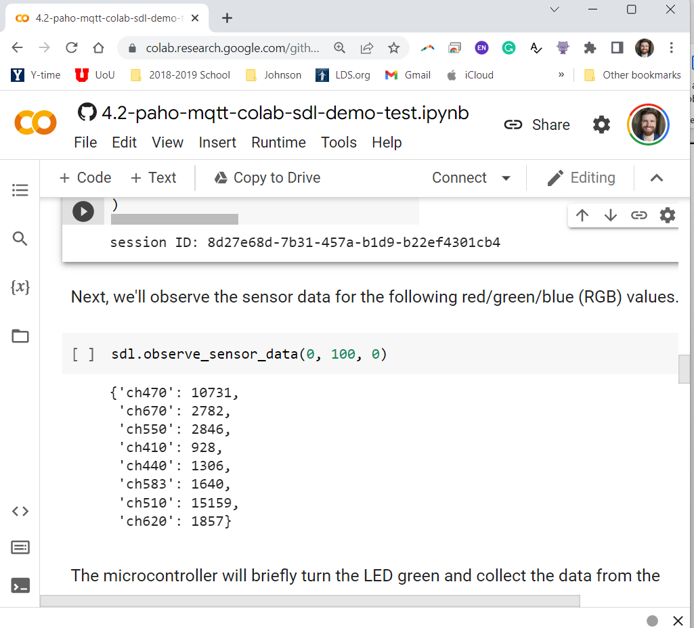


5 min
20 min
Order parts, verify prereqs
Standalone DigiKey order
Ensure 2.4 GHz network
Hardware assembly
Sensor mounting
Firmware preparation
Step 1
Step 2
Step 3
Step 4
Software Setup
Firmware installation
Source files
Cloud-based control
Google Colab notebook
Optimization comparison
20 min
10 min

Slide 4
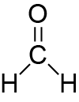
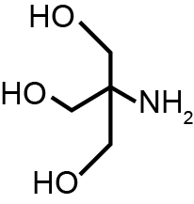




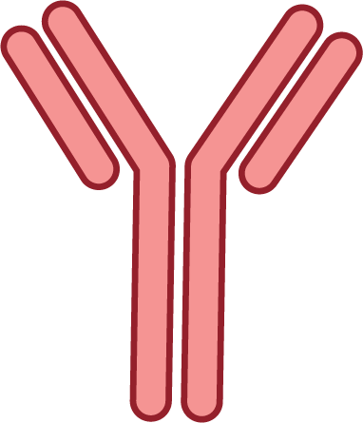
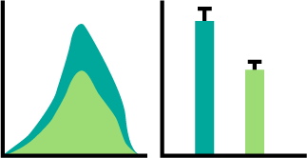
Step 1
Step 2
Day 1
Day 2
Grow
Crosslink
Quench
Lyse cells
Fragment chromatin
EXAMPLE FIGURE
Step 3
Step 4
Day 3
Day 4
Immunoprecipitation
Quantify binding

Slide 5





Samples collection
TMT10plex Mass tag labelling
(min)
10
20
30
60
(0-90 min)
0
Control
x10
TMT10plex Set 1
(min)
15
25
40
90
5
(0-90 min)
Phosphatase mutant
x10
TMT10plex Set 2
Day 1
Day 3-4
Step 2
Day 1-2
Step 1
Timing
Day 2
Combine
Phosphopeptide enrichment using SMOAC
EXAMPLE FIGURE
Titanium
dioxide
(TiO₂)
+
Ferric
nitrilotriacetate
(Fe-NTA)
+
Set 1
Set 2
Day 4
Day 3
Day 5
Step 4
Step 3
Mass spectrometry analysis
Day 4
Timing
Intensity
MS/MS
m/z
Day 6
Step 5

Slide 6
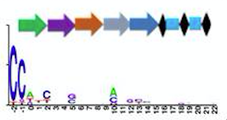
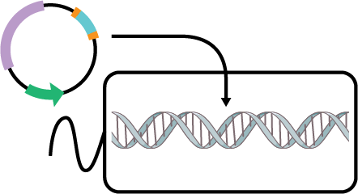
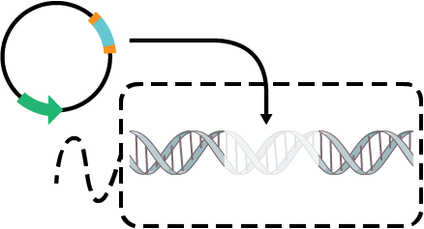
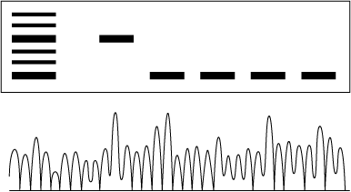
pEditing
4-6 hours
4-5 days
Step 1. In silico characterization of the native CRISPR-Cas system
Step 3. Construction of pEditing and genome editing
EXAMPLE FIGURE
Step 2. Construction of pTargeting and self-targeting assay
Step 4. Verification of genome editing
4-5 days
6-8 hours
pTargeting

Slide 7
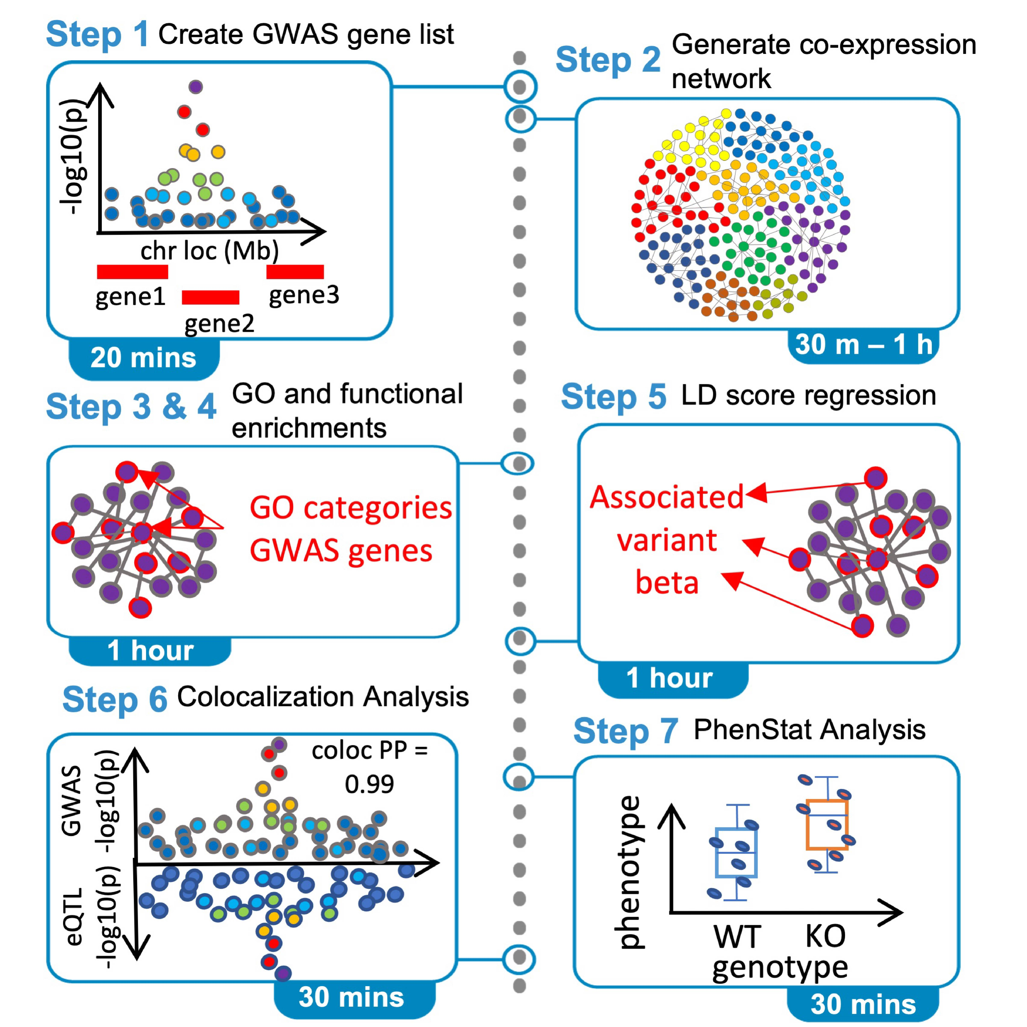
EXAMPLE FIGURE
Sabik et al., 2021

Slide 8
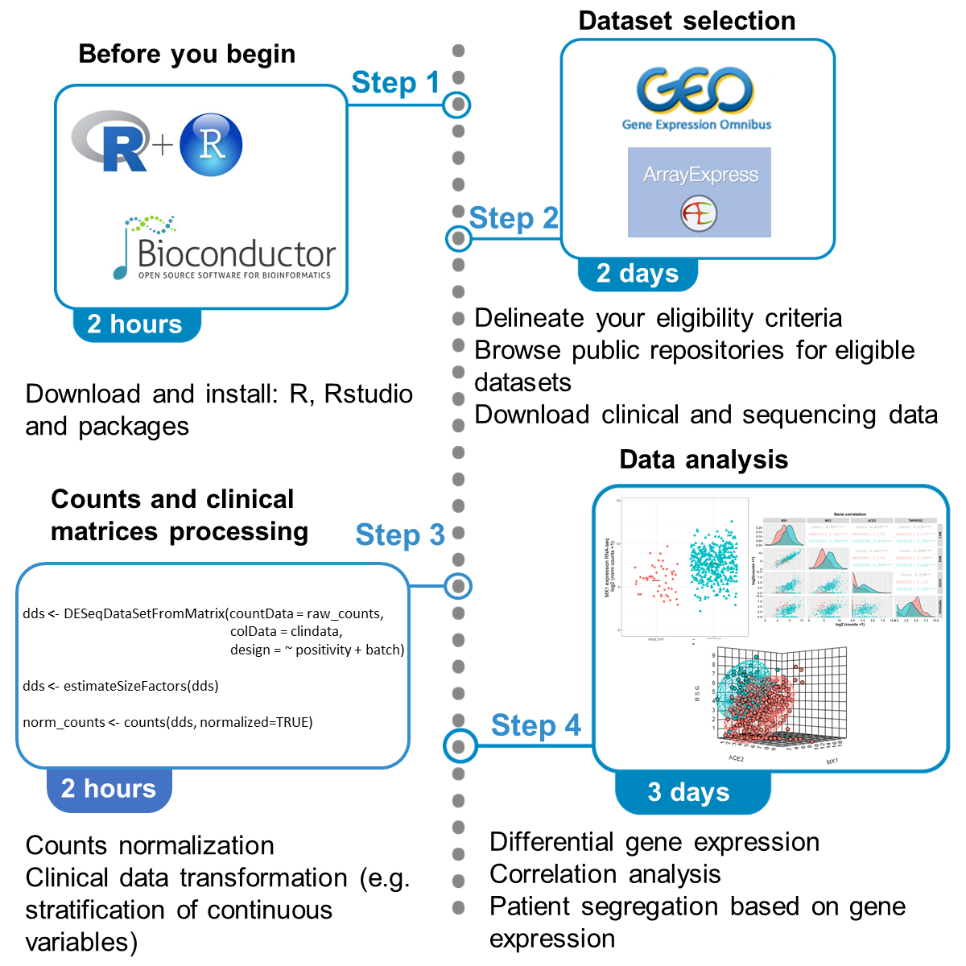
EXAMPLE FIGURE
Sanchis et al., 2021

Slide 9

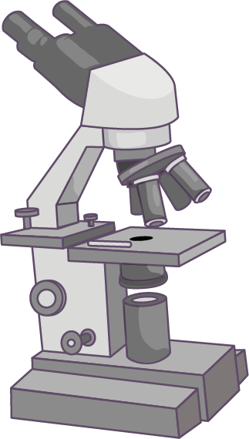


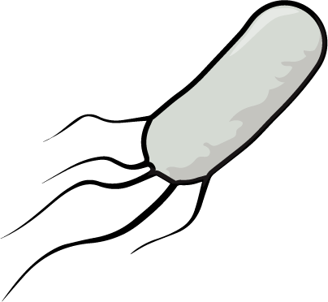
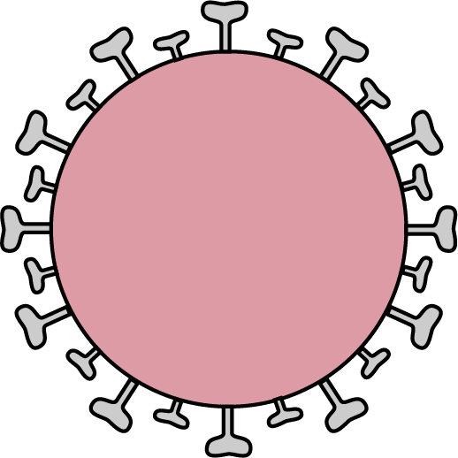

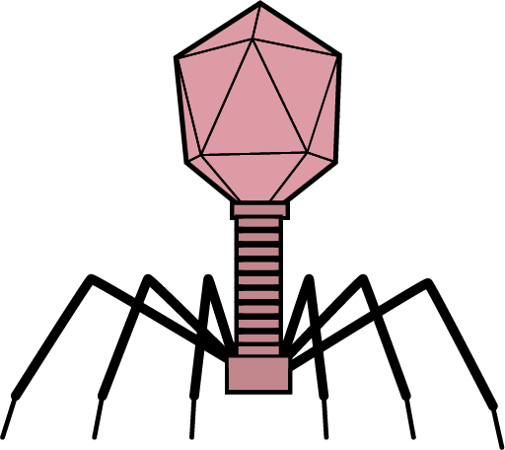


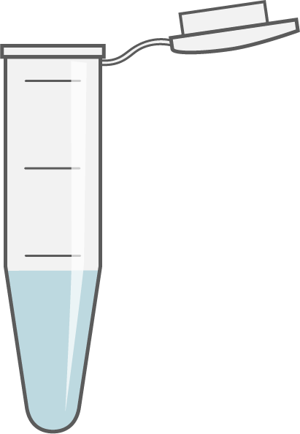
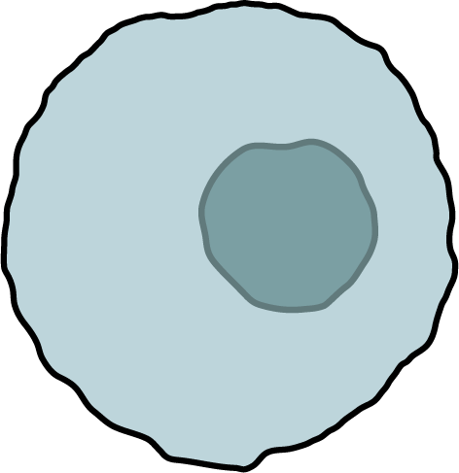
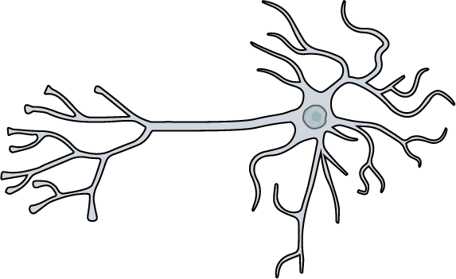
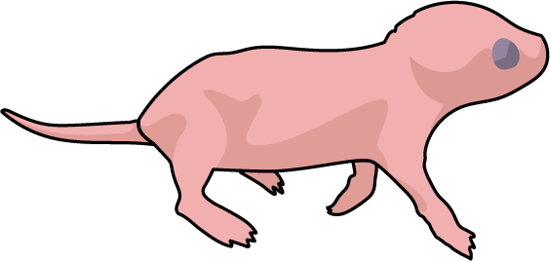

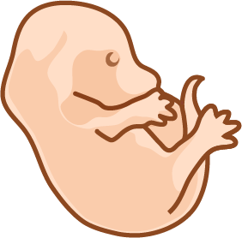
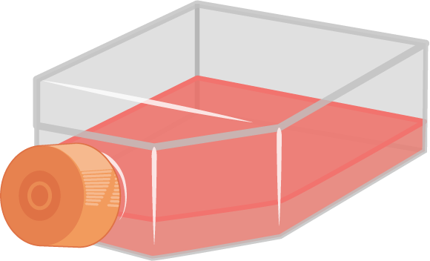






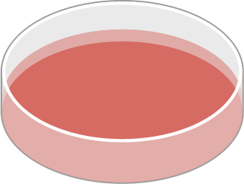

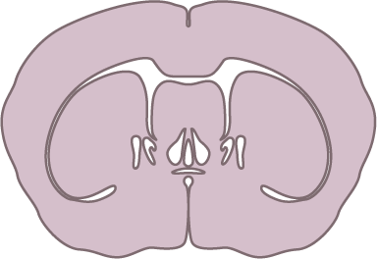
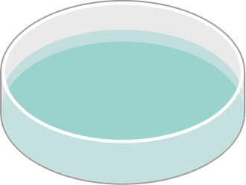

General Assets

Slide 10


Template/Timeline Assets

